Slide 1
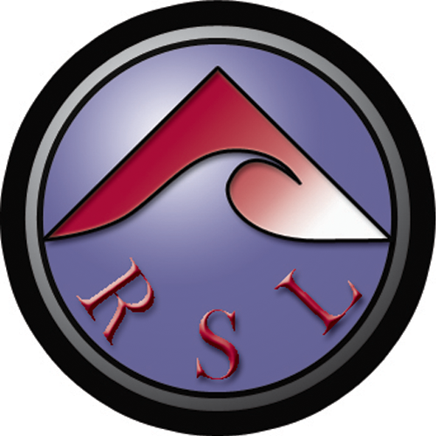

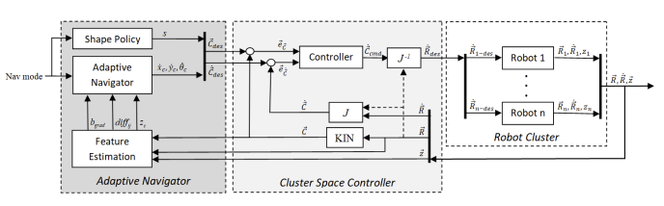
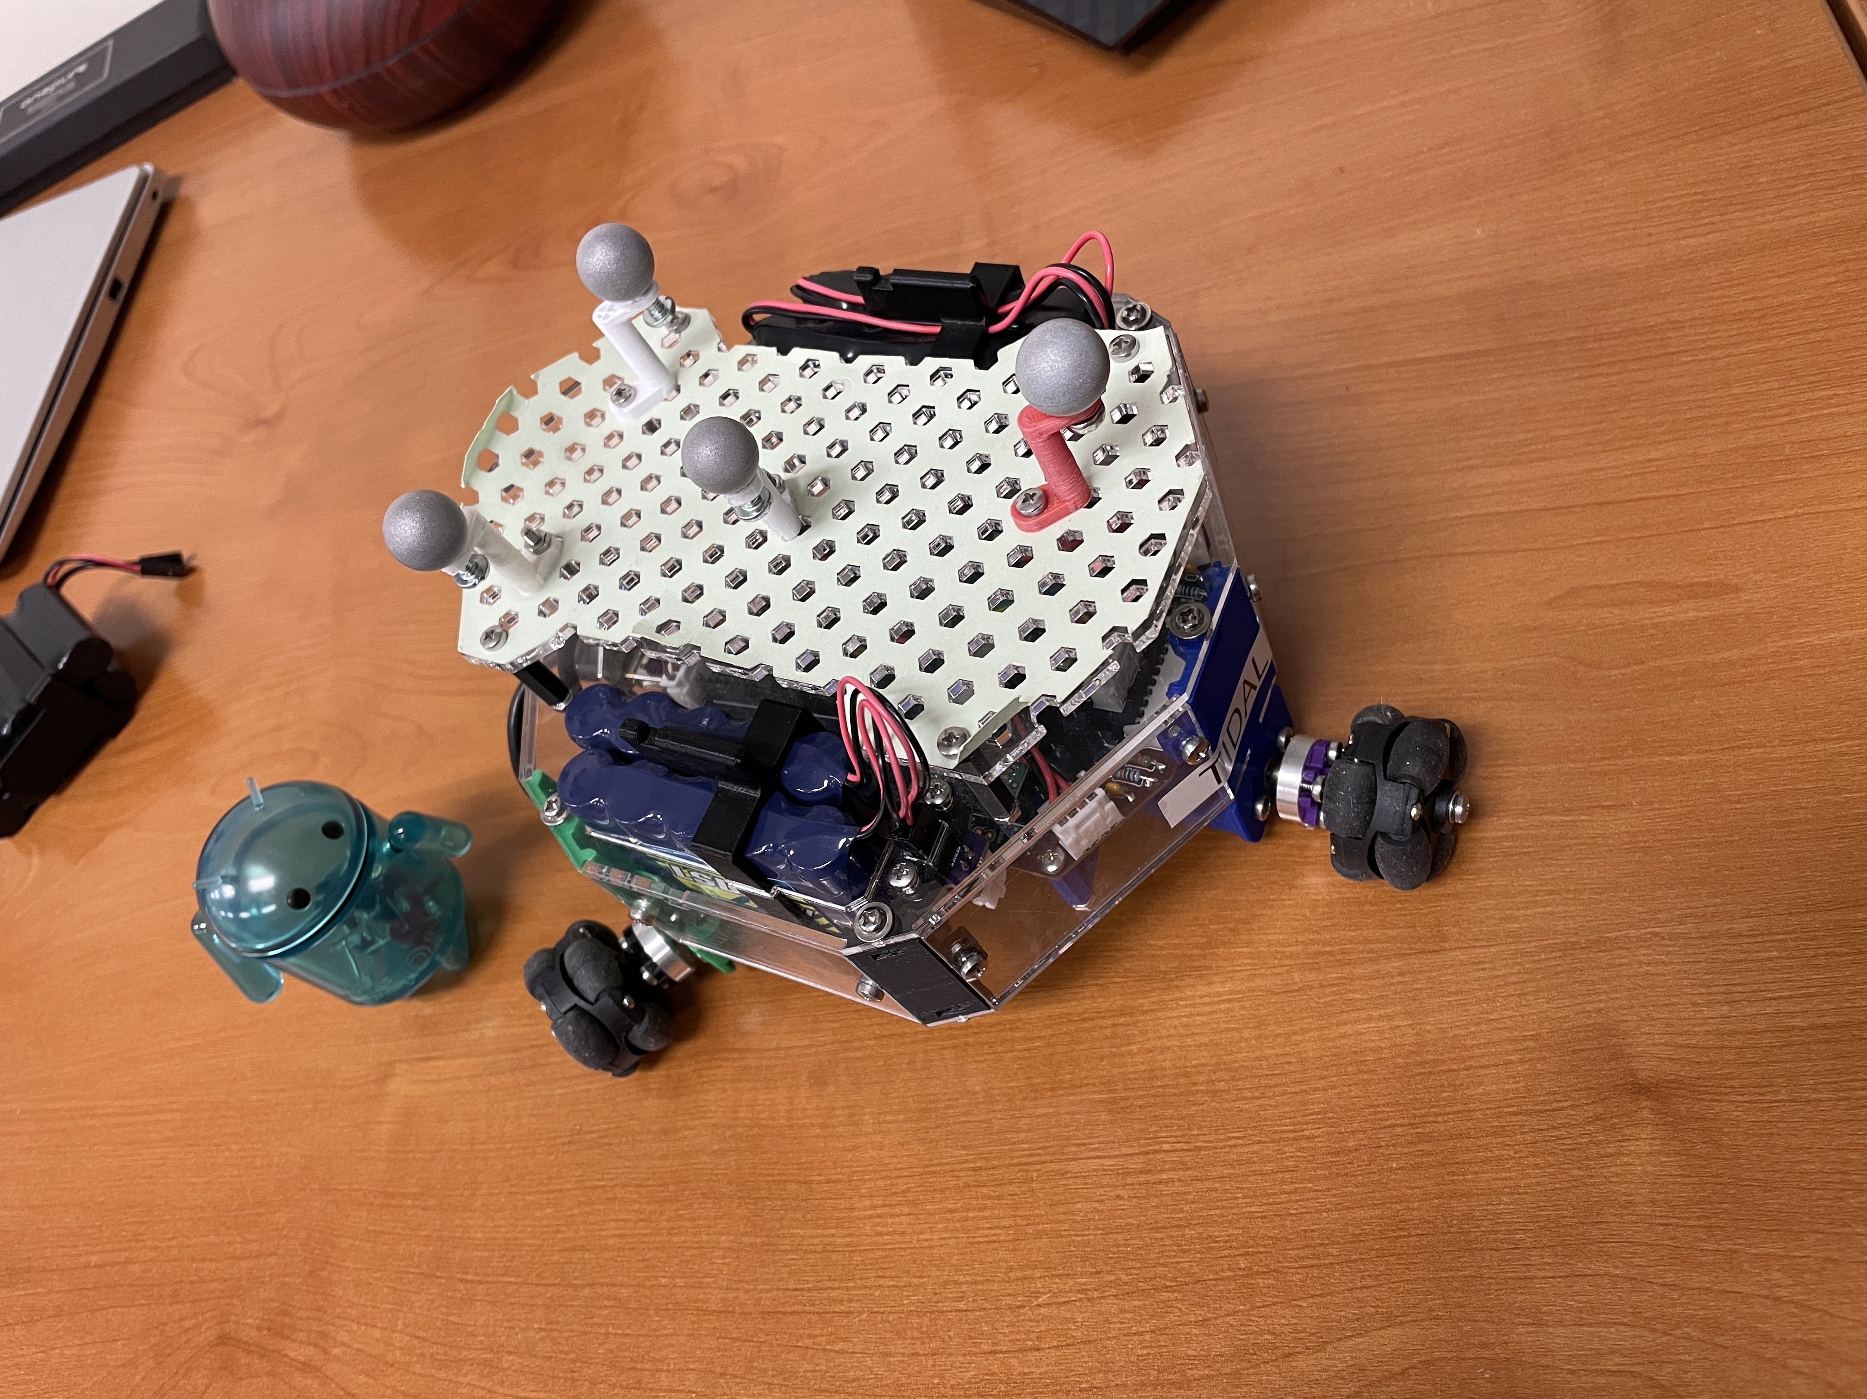
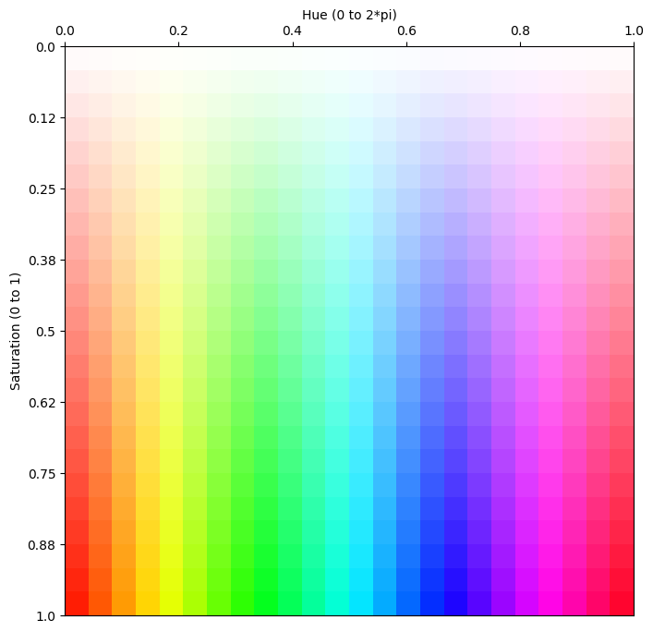
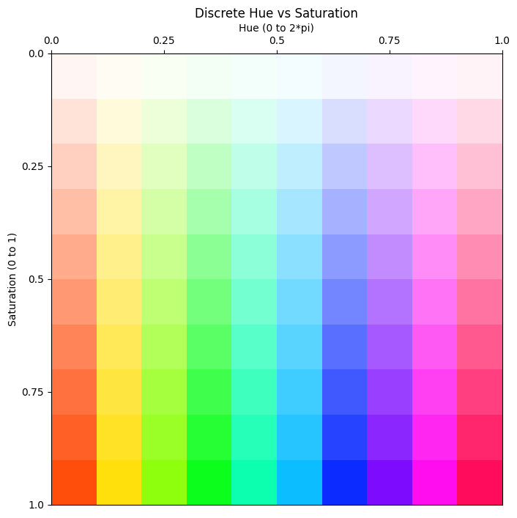
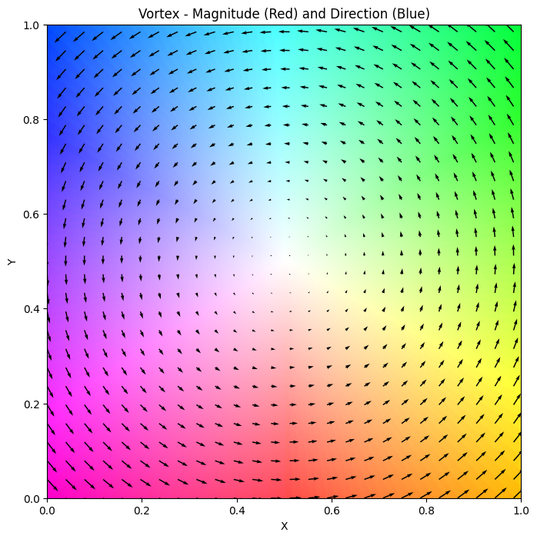
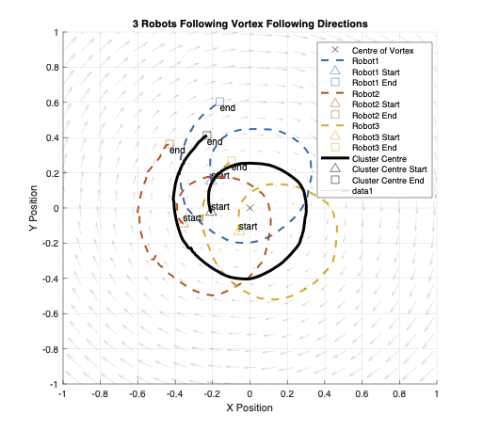
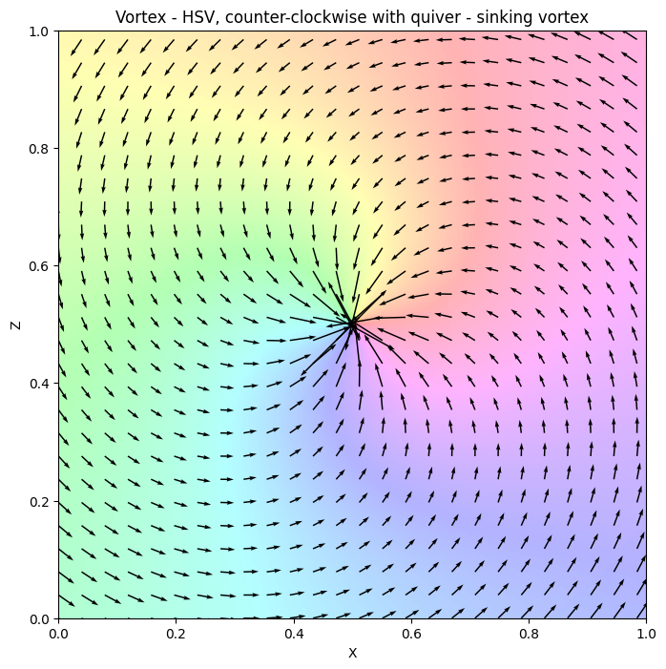
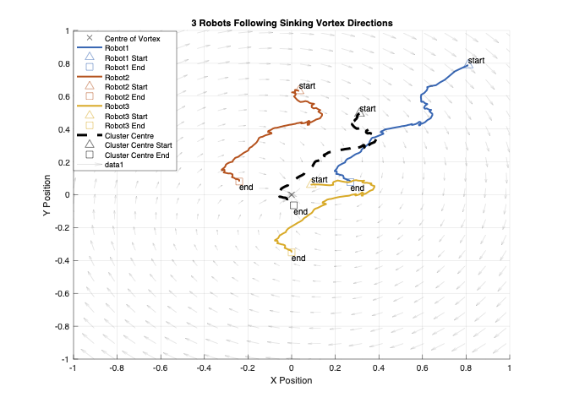
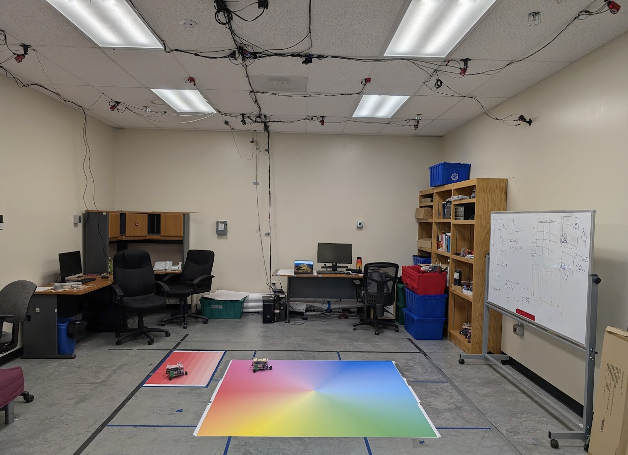
A Functional Indoor Testbed for 2D Vector Field Multirobot Adaptive Navigation
Author: Christopher Waight, cwaight@scu.edu
Advisor: Dr. Christopher Kitts, ckitts@scu.edu
Background
Test Bed Design
Results
Significance
Adaptive Navigation of Multirobot Systems (MRS) in physical vector fields is crucial for applications in harsh or communication-denied environments, including disaster response, environmental monitoring, and extraterrestrial exploration. While adaptive navigation in scalar fields is well-established, extending these methods to vector fields presents significant challenges.
Control Architecture
Predictions on Training Data
This system was able to recover Hue with an R² of 0.961 and Saturation with an R² of 0.954, effectively resolving the channel interference issue.
This system also enables continuous robot sampling at a rate of 10Hz, 70x faster than the old test bed, enabling continuous robot sampling and continuous robot motion.
This system also bridges the Sim2Real gap allowing for real world verification of work that was limited to theory and simulation.
Fig 3. Control layers including Cluster Space Controller for closed form Jacobians and Jacobian Inverse, guaranteeing stability.
Fig 5. Plots of Predicted vs Actual for Hue and Saturation. Individually tuned robots perform even better.
Problem
Multirobot System
Predictions on Testing Data
Vector Field environments are often dynamic and have features of interest that change location with time, necessitating Adaptive Navigation (AN) Control laws. Further challenges arise when bridging the gap from experimental results in Simulation to Real World (Sim2Real) environments.
Prior work at SCU has demonstrated the use of the RGB color channels to represent orthogonal vectors. This approach suffered from low accuracy due to channel interference and low sampling frequency of 0.15 Hz. Thus, previous test beds had limited abilities in representing vector fields.
Future Work
Next steps for this research include:
Using the test bed to validate simulations of new control primitives to find features of interest in vector fields, including stagnation points and separatrices
Using the system’s ability to reproduce direction and magnitude of vectors to test the real-world dynamics of MRS systems, and more advanced controllers.
Fig 1. An example of a Decabot, an omnidirectional rover equipped with an RGB sensor. Developed at SCU.
Fig 6. Plots of Predicted vs Actual for Hue and Saturation. Testing on unseen data helps detect potential overfitting.
HSV Color Space and Supervised Machine Learning
Direction Following in a Vortex
Objective
Conclusion
Fig 2. Training and Testing Plots. These Hue vs Saturation pallets are used to represent the angle and magnitude of different vectors.
Training was done using MATLAB’s Deep Learning Toolbox.
Fig 7. Positions of three robots and the cluster centre as they follow the sensed vectors of the sinking vortex.
This project was successful in achieving its objectives, overcoming the limitations of previous test beds. It resolves the channel coupling issue, to represent all directions at a wide range of magnitudes.
This test bed was also used for experimental verification of continuous multirobot performance results from previous studies that were only performed in simulation.
To develop and validate a new indoor test bed for MRS adaptive navigation in vector field environments. This test bed must:
Accurately represent all vector directions across a wide range of magnitudes.
Allow for continuous robot motion.
Have multi-robot capabilities.
Allow for verification in a quantifiable way.
OptiTrack Motion Capture System
Source Seeking in a Sinking Vortex
Fig 4. MultiRobot Test Bed Under OptiTrack System
Fig 8. Positions of three robots and the cluster centre as they find the centre of the sinking vortex.

